Slide 1

SRI SARATHI INSTITUTE OF ENGINEERING AND TECHNOLOGY
SUSPICIOUS ACTIVITY DETECTION FROM CCTV FOOTAGE
BY :
N.Satish kumar(19541A0578)
V.Naga Pavan Durga(20545A0506)
B.Sai Chandana(19541A0506)
M.Venkata Vamsi(19541A0572)
M.Lakshmi Susmitha(19541A0522)
Guide Name:
V.Babu Rao
Asst.Professor,Dept.CSE

Slide 2
CONTENTS:
INTRODUCTION
ABSTRACT
SYSTEM ANALYSIS
SYSTEM ARCHITECTURE
LITERATURE SURVEY
SYSTEM REQUIREMENTS
CONCLUSION
REFFERENCES

Slide 3
INTRODUCTION:
In recent years the violence or the crime rate is increasing all over the world. In order to minimize or to control the situation various aids are used. The video surveillance is the best option which can be used in private as well as for public places. The video surveillance is said to be effective when it detect any abnormal /suspicious activities efficiently. Most of the current surveillance systems are human operated. So they require continuous human attention to detect any abnormal activity. As the human is involved the efficiency of the system decreases with time due to fatigueness factor of human. This problem can be solved by the automation of the video surveillance. The function of the automated system is to give indication in the form of alarm or any other form when the predefined abnormal activity is happen. Dr. C.G.Patil Dept. of E & TC SAE, Pune Pune, India Cgpatil.sae@sinhgad.edu In this paper a semantic based approach is used to define & detect the suspicious activities. The framework of the system consists of defining suspicious activity, background subtraction, objects detection, tracking & classification of activities. The suspicious activities are defined using Semantic approach which applies the human understanding of the activity. The motion features between the two/different objects are extracted to detect the behavior.

Slide 4
ABSTRACT:
In today’s insecure world the video surveillance plays an important role for the security of the indoor as well as outdoor places. The components of video surveillance system such as behavior recognition, understanding and classifying the activity as normal or suspicious can be used for real time applications. In this paper the hierarchical approach is used to detect the different suspicious activities such as loitering, fainting, unauthorized entry etc. This approach is based on the motion features between the different objects. First of all the different suspicious activities are defined using semantic approach. Then the object detection is done using background subtraction. The detected objects are then classified as living (human) or non living (bag). These objects are required to be tracked which is done using correlation technique. Finally using the motion features & temporal information the events are classified as normal or suspicious. As the semantic based approach is used computational complexity is less and the efficiency of the approach is more.

Slide 5
SYSTEM ANALYSIS:
EXISTING SYSTEM
The video surveillance is said to be effective when it detect any abnormal /suspicious activities efficiently. Most of the current surveillance systems are human operated. So they require continuous human attention to detect any abnormal activity. As the human is involved the efficiency of the system decreases with time due to fatigueness factor of human. This problem can be solved by the automation of the video surveillance. The function of the automated system is to give indication in the form of alarm or any other form when the predefined abnormal activity is happen.
The main objective of video surveillance is to acquire & process the data so that any suspicious movement can be detected. A lot of research has been done addressing the detection of anomalies in the video data. The problem of abandoned bag detection is handled by the most of the researchers. Bitch et. al, Tian et. al. they handled the abandoned bag detection problem as the static object detection with the application of the object tracking.

Slide 6
While Evangelio & Sikora, Porikli et. al. they did the static object detection without the use of tracking. In Elhamod & Levine proposed a technique based on semantic approach to detect suspicious activity in public places. They use the background subtraction to identify the foreground object. This object is tracked using the foreground silhouettes. Then the activities are classified as normal or predefined suspicious activity. In James David Hogg et al described the video surveillance framework to detect abandoned object in scene with multiple interacting objects. They use the standard datasets. The object (bag) detection is done by the dual background approach using Gaussian Mixture Model(GMM)
The multi hypothesis tracker which is modified for tracking of extended objects is used. Then the situation analysis is done based on relationship between bag and people. Finally the threat assessment is done using logic based approach. In Fuentes & Velastin present an algorithm based on trajectories to detect an event in video surveillance. Any event can be described in terms of position, trajectory, and split/ merge event. Then the matching matrices are used for tracking purpose. Kim et al deal with detecting & tracking multiple moving objects through a single camera.

Slide 7
DRAWBACKS OF EXISTING SYSTEM:
CCTV cameras are connected with computers,laptops or smart phones therefore they are vulnerable.
Cameras are very expensive to upgrade.
The CCTV system can be easily manipulates and compromised by the hackers.
The CCTV cameras are silky and small in size and hence can be broken easily.

Slide 8
PROPOSED SYSTEM:
In this paper a semantic based approach is used to define & detect the suspicious activities.
The framework of the system consists of defining suspicious activity, background subtraction, objects detection, tracking & classification of activities. The suspicious activities are defined using Semantic approach which applies the human understanding of the activity.
The motion features between the two/different objects are extracted to detect the behaviour.

Slide 9
ADVANTAGES OF PROPOSED SYSTEM:
INCREASED PUBLIC SAFETY One of the most obvious benefits of placing CCTV and Security Surveillance in public places is enhanced public safety.
ARRIVING AT THE RIGHT DECISIONS When you have the proof of the event with you as the footage, it helps you to drive the fair and take right decisions.
TRAFFIC CONTROL “The Government Authorities are recording you in public” .
SENSE OF SECURITY

Slide 10
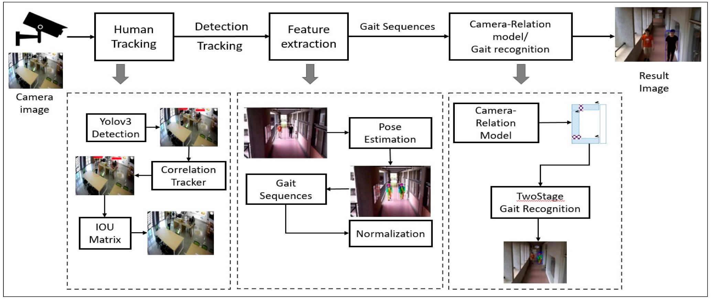
SYSTEM ARCHITECTURE:

Slide 11
LITERATURE SURVEY:
1.TITLE: a real-time blob matching technique. Using temporal and spatial properties of these blobs, activitiesSuspicious Movement Detection and Tracking based on Color Histogram
AUTHOR: Sandesh Patil and Kiran
ABSTRACT: In automated video surveillance applications, detection of suspicious human behaviour is of great practical importance. However due to random nature of human movements, reliable classification of works for surveillance systems installed in indoor environments like entrances/exits of buildings, corridors, etc. Our work presents a framework that processes video data obtained from a CCTV camera fixed at a particular location. First, we obtain the foreground objects by using background subtraction. These foreground objects are then classified into people and inanimate objects (luggage). These objects are tracked using are classified using semantics-based approach.

Slide 12
2.TITLE: Robust abandoned object detection using dual foregrounds
AUTHOR: Porikli F Ivanov Y Haga T
ABSTRACT: As an alternative to the tracking-based approaches that heavily depend on accurate detection of moving objects, which often fail for crowded scenarios, we present a pixelwise method that employs dual foregrounds to extract temporally static image regions. Depending on the application, these regions indicate objects that do not constitute the original background but were brought into the scene at a subsequent time, such as abandoned and removed items, illegally parked vehicles. We construct separate long- and short-term backgrounds that are implemented as pixelwise multivariate Gaussian models. Background parameters are adapted online using a Bayesian update mechanism imposed at different learning rates. By comparing each frame with these models, we estimate two foregrounds. We infer an evidence score at each pixel by applying a set of hypotheses on the foreground responses, and then aggregate the evidence in time to provide temporal consistency. Unlike optical flow-based approaches that smear boundaries, our method can accurately segment out objects even if they are fully occluded. It does not require on-site training to compensate for particular imaging conditions. While having a low-computational load, it readily lends itself to parallelization if further speed improvement is necessary.

Slide 13
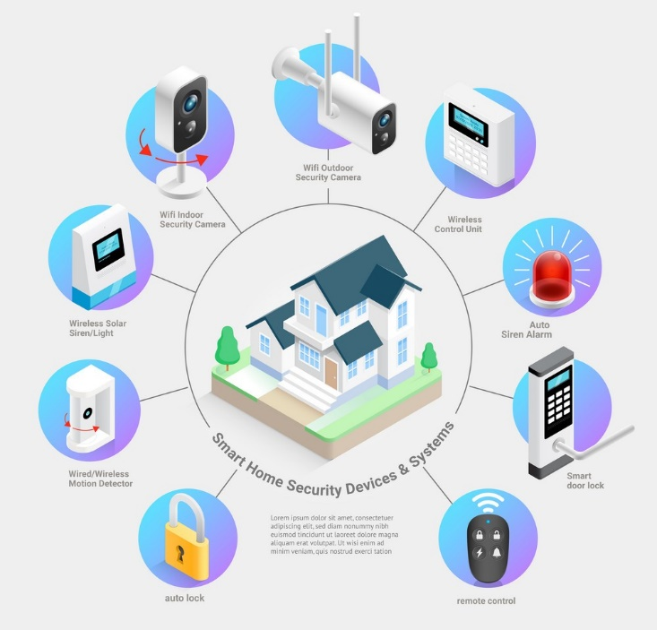
SMART HOME SECURITY DEVICES & SYSTEMS

Slide 14
MODULES:
Input data-
The input for the system is video stream. As the system is to be implemented to detect the suspicious activity its input is to be taken from the CCTV. But for the project/ demo we use the standard datasets. These input images are not in proper form so the different image preprocessing techniques are used to enhance the quality of the image.
Background image acquisition-
The illumination effect can be corrected by the background image. A reference image/ standard background is taken as reference for the further image processing. The background image is dynamically updated so that any new object entered in the scene can be captured.

Slide 15
IMAGE PROCESSING:
The different image preprocessing techniques are used to improve the image so that the unwanted distortions are get suppressed or some required features enhanced. The changing light conditions, movement of reference background cause some noise introduced in the image. We use the thresholding technique to
remove the noise. Then the image undergoes the morphological operations. The Morphologically open operation is used to shrink the area which is distorted
by the noise.
Object Detection-
The foreground image is obtained by the subtraction of the input image from the background image. From this foreground image the required object is detected
Object Tracking-
in the scene or if any object left the scene i.e. the person walk off the scene. The detected object (human being or bag) is tracked using correlation tracking algorithm.
The detected object is tracked in the scene so that we can determine if any new object is entered

Slide 16
SYSTEM REQUIREMENTS:
HARDWARE REQUIREMENTS:
System : Intel i3 2.2Ghz
Hard Disk : 320 GB.
Ram : 4 GB.
SOFTWARE REQUIREMENTS:
Operating system : Windows 7 Ultimate.
Coding Language : Python.
Front-End : Python.
IDE : Pycharm 2020 Community.

Slide 17
REFERENCES:
[1] Sandesh Patil and Kiran Talele “Suspicious Movement Detection and Tracking based on Color Histogram”, 2015 International Conference on Communication, Information & Computing Technology (ICCICT), Jan. 16-17.
[2] Mohannad Elhamod, and Martin D. Levine, “Automated Real-Time Detection of Potentially Suspicious Behavior in Public Transport Areas”,IEEE Transactions On Intelligent Transportation Systems, Vol. 14, No.2, June 2013.
[3] Evangelio, R., Sikora, T., “Static object detection based on a dual background model and a finite-state machine”. EURASIP Journal on Image and Video Processing 2011

Slide 18
[4] Birch, P., Hassan, W., Bangalore, N., Young, R., Chatwin, C., “Stationary traffic monitor”. In Proc. 4th Internat. Conf. on Imaging for Crime Detection and Prevention (ICDP-11), pp. 1–6, 2011.
[5] Tian, Y., Feris, R., Liu, H., Humpapur, A., Sun, M.-T., “Robust detection of abandoned and removed objects in complex surveillance videos”. In Proc. IEEE 2010.
[6] Porikli, F., Ivanov, Y., Haga, T., 2008. “Robust abandoned object detection using dual foregrounds” EURASIP Journal on Advances in Signal Processing 2008.
[7] James Ferryman et al, “Robust abandoned object detection integrating wide area visual surveillance and social context” in Pattern Recognition Letters 34 (2013) 789–798 Elsevier 2013.

Slide 19
CONCLUSION:
In this work, a semantics-based activity detection approach that depends on object tracking is used. It uses the motion features and spatial relation between two objects. The features are continuously checked against predefined conditions, to detect the prescribed activities of interest. The approach is simple for real-time performance, and it eliminates the training required by machine-learning-based methods.

Slide 20


